Slide 1
MY JOURNAL TO PYTHON
4110E210
MY DEAR GREAT TEACHER

Slide 2
AGENDA
Python
Input and Output : input() and print
Data Types : numeric, string, list, dict.
Operation ON data type:
CONTROLS : IF- | IF –ELSE IF | -F-ELSE
LOOP : FOR |WHILE | RANGE () |BREAK | CONTINUE
FUNCTION
PARAMETERS (ARGUMENTS)
RECURSIVE FUNCTION
LAMBA FUNCTION

Slide 3
What is Python?
Python is a popular programming language. It was created by Guido van Rossum, and released in 1991.
It is used for:
web development (server-side),
software development,
mathematics,
system scripting.
What can Python do?
Python can be used on a server to create web applications.
Python can be used alongside software to create workflows.
Python can connect to database systems. It can also read and modify files.
Python can be used to handle big data and perform complex mathematics.
Python can be used for rapid prototyping, or for production-ready software development.
Why Python?
Python works on different platforms (Windows, Mac, Linux, Raspberry Pi, etc).
Python has a simple syntax similar to the English language.
Python has syntax that allows developers to write programs with fewer lines than some other programming languages.
Python runs on an interpreter system, meaning that code can be executed as soon as it is written. This means that prototyping can be very quick.
Python can be treated in a procedural way, an object-oriented way or a functional way.

Slide 4
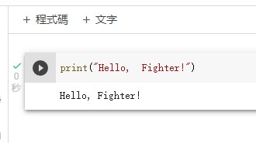
Example
Good to know:
The most recent major version of Python is Python 3, which we shall be using in this tutorial. However, Python 2, although not being updated with anything other than security updates, is still quite popular.
In this tutorial Python will be written in a text editor. It is possible to write Python in an Integrated Development Environment, such as Thonny, Pycharm, Netbeans or Eclipse which are particularly useful when managing larger collections of Python files.

Slide 5
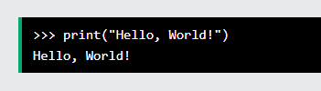

Python Syntax
Python syntax can be executed by writing directly in the Command Line:
Or by creating a python file on the server, using the .py file extension, and running it in the Command Line:

Slide 6
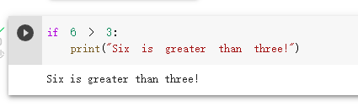
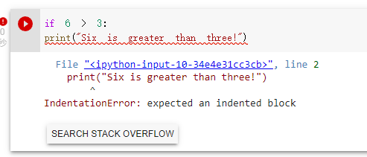
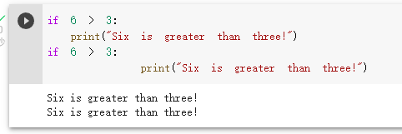
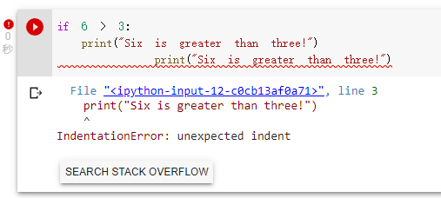
Python Indentation
Example
Python uses indentation to indicate a block of code.
Python will give you an error if you skip the indentation:
Indentation refers to the spaces at the beginning of a code line.
Where in other programming languages the indentation in code is for readability only, the indentation in Python is very important.
The number of spaces is up to you as a programmer, the most common use is four, but it has to be at least one.
You have to use the same number of spaces in the same block of code, otherwise Python will give you an error:

